Slide 1
Web Technologies
(CP301)
Credits: 6 (Lect: 2+ Lab: 4)
Reference Book(s):
Developing Web Application, Ralph Moseley, Wiley India
Web Design, Joel Sklar, Cengage Learning

Slide 2
Chapter 1:
Introduction to Web Technology

Slide 3
Outline
Web page, web site, web browser, web server
World Wide Web, Internet
Protocols and programs
HTTP Protocol: Request and Response
Feature of Web 2.0

Slide 4
Web page, web site, web browser, web server
Web page: A Simple document with extension like .html or .htm or .php or phtml or .aspx etc.
Web site: A collections of web pages, java script, CSS, images, flash files etc.
Web browser: It is client side software, interprets the HTML code. A browser can only understand HTML code.
Web server: A Collection of web sites along with database.

Slide 5
WWW and internet
WWW: stands for World Wide Web.
  The World Wide Web is an information space where documents and other web resources are identified by Uniform Resource Locators (URLs), interlinked by hypertext links, and can be accessed via the Internet.
  Comprises of files, folders & documents stored in various computers
Internet:
  The Internet is the global system of interconnected computer networks that use the Internet protocol suite (TCP/IP) to link devices worldwide.
  It is a network of networks that consists of private, public, academic, business, and government networks of local to global scope, linked by a broad array of electronic, wireless, and optical networking technologies.
  Comprises of Network of Computers, copper wires, fiber-optic cables & wireless networks

Slide 6
Protocol and Programs
Protocol:
  Set of rule that governs the communication.
  An agreed-upon format for transmitting data between two devices.
  Information that travels over the Internet does so via a variety of languages known as protocols.
Programs:
  A document with .php or .aspx or .jsp extension, executes on Server.

Slide 7
HTTP: Request and Response
The main protocol used for communication between a browser and a we server is HTTP.
http://www.bvmengineering.ac.in/index.php
192.168.18.32
port 80
GET index.php
HTTP/ 1.0
HTTP/ 1.1 200 OK
[content of doc]
Client (Browser)
Server
Client (Browser)
Server
Client (Browser)
Server
Client (Browser)
Server

Slide 8
HTTP: Request and Response (cont…)
The following HTTP commands originate from server to request a web page from server.
  GET /index.php HTTP/1.0
Server Responds with:
HTTP/ 1.1 200 OK
Code which can be responded by server:
  200: OK
  404: Not Found
  401: Unauthorized
  500: Internal Server Error
  501: Not Implemented

Slide 9
The Web Browser
The primary purpose of a web browser is to bring information resources to the user ("retrieval" or "fetching"), allow them to view the information ("display", "rendering"), and then access other information ("navigation", "following links").
User interface:
Back and forward buttons to go back to the previous resource and forward respectively.
A refresh or reload button to reload the current resource.
A stop button to cancel loading the resource. In some browsers, the stop button is merged with the reload button.
A home button to return to the user's home page.
An address bar to input the Uniform Resource Identifier (URI) of the desired resource and display it.
A search bar to input terms into a search engine. In some browsers, the search bar is merged with the address bar.
A status bar to display progress in loading the resource and also the URI of links when the cursor hovers over them.

Slide 10
The Web Browser
Keyboard and Mouse
Controller
HTML
Interpreter
Display
Drivers
Plug-ins
Other
interpreter
Other
Client
Network
Interface
HTTP
Client

Slide 11
Web Design Principles
There are 4 principles:
      Design for Medium
      Design the whole site
      Design for User
      Design for Screen

Slide 12
Web Design Principles
      Design for Medium:
        A Web site is designed for the computer – not for paper
  Look and Feel:
  The interface that the user must navigate often is called the look and feel of the Web site.
  Look and feel implies the personality that the Web site conveys to the user and the way it works.

Slide 13
Web Design Principles
      Design for Medium:
  Make your Design Portable:
  The Web site must be portable across different browsers, OS and computer platforms.
  Test the website in different browsers such as Internet Explorer, FireFox, Google Chrome, Opera, etc.
  Certain features of HTML like cascading style sheets cannot be interpreted properly by certain browsers.
  If necessary, design separate websites for different types of browsers; detect the user’s browser and direct him to appropriate version of the Web site
  Check website in different browsers; a website designed for a desktop PC may not be usable on a mobile device.

Slide 14
Web Design Principles
      Design for Medium:
  Design for Low Bandwidth :
  Different types of Internet connections are used – dial-up, broadband, cable, etc.
  Plan your pages so that they are accessible at different connection speeds.
  Avoid large images, complicated animations, movies as these take time to download.
  Provide alternate text (by using the ALT property of HTML)
  Design an alternate page that uses less graphics so that it will download quickly for users with a slow connection.

Slide 15
Web Design Principles
      Design for Medium:
  Plan for Clear Presentation of Information :
  Information design (ID) means the presentation and organization of your information. ID is the most important factor in determining the success of a Web site.
  Don’t use too many fonts & colors as this distracts the user.
  Provide direct links to the areas in the Web site that you think are the most in demand.
  Use contrasting colors so that the text is easy to read.
  On the computer screen, users tend to scan rather than read the whole page.

Slide 16
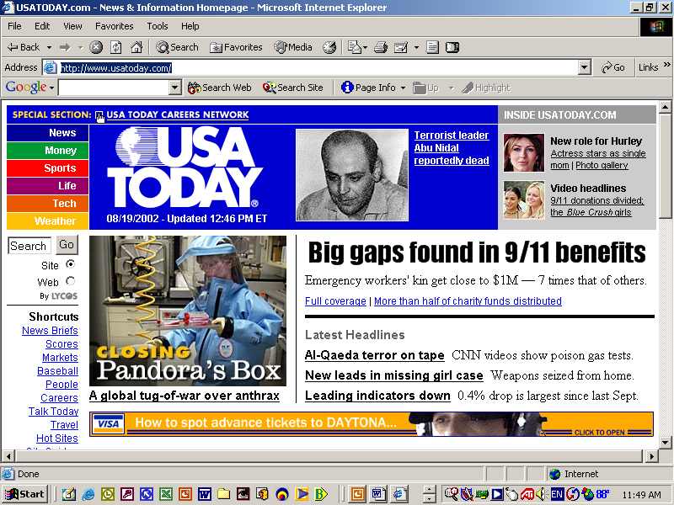

Web Design Principles

Slide 17
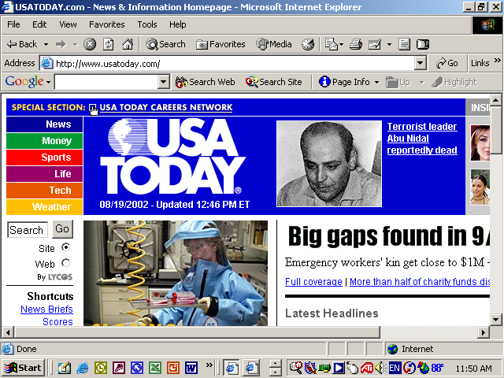
Web Design Principles

Slide 18
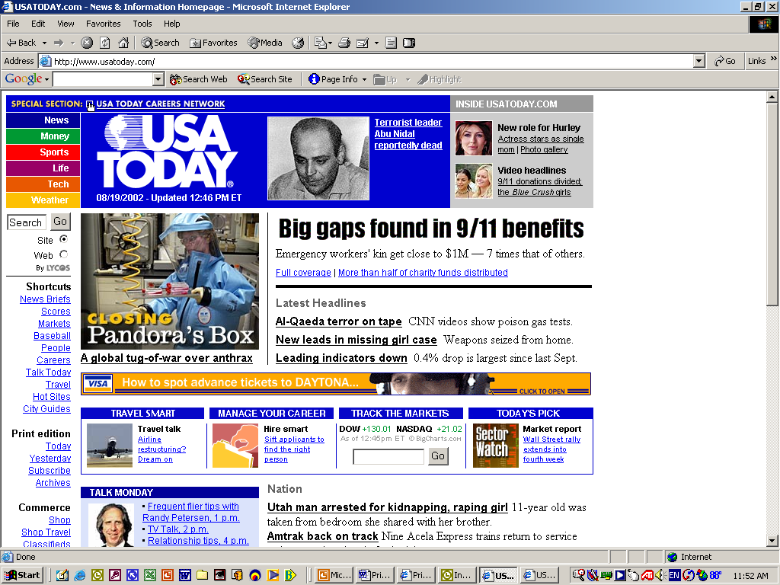
Web Design Principles

Slide 19
Web Design Principles
      Design the Whole Site:
  When designing the site, plan the unifying themes and structure that will hold the pages together.
  The theme should reflect the personality of your organization
  If designing a site for children, consider use of visuals, bright colors, and lively animations, big font

Slide 20
Web Design Principles
      Design the Whole Site:
  Create Smooth Transitions:
  Create a unified look among the pages
  Reinforce the identifying elements of the site
  Create smooth transitions from one page to another – this is done by repeating colors and fonts for similar page elements.
  E.g., all para headings in a particular font and color on all pages
  All body text in a particular color and font style on all pages.

Slide 21
Web Design Principles
      Design the Whole Site:
  Use of Grid to Provide a Visual Structure :
  A grid is a way of organizing a page into rows and columns.
  A grid can provide a uniform look (consistency) to all the pages of a site.
  The TABLE element of HTML can be used to build the grid for pages.
  Another way of creating a grid is by using the concept of frames (FRAMESET tag)

Slide 22
Web Design Principles
      Design the Whole Site:
  Use of Active White Space :
  White spaces are the blank areas of a page.
  White space is the area between text, images, paragraphs, etc
  White use that is used purposely is called active white space.
  Passive white spaces are the blank areas that appear on the border of the screen due to screen resolution problems

Slide 23
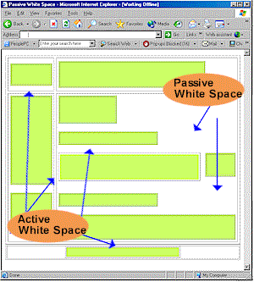
Web Design Principles
      Design the Whole Site:
  Use of Active White Space :

Slide 24
Web Design Principles
      Design the Whole Site:
  Use of Active White Space :
  A lack of white space creates the impression that the page contains too much information
  It is difficult to find information on a page that does not have sufficient active white space.
  Plenty of active white space reduces confusion.
  Provide navigation elements on the same position in all pages – this provides uniformity and ease of use.

Slide 25
Web Design Principles
      Design for the User:
  Keep in mind the user
  Why has the user come to your Web site?
  What type of information does the user want?
  Is the site for information, entertainment, ..?

Slide 26
Web Design Principles
      Design for the User:
  Design for Interaction:
  Think about how the user will interact with the Web page
  If the page is a collection of links, interaction will be clicking on the content and scrolling
  Pointing to graphics and clicking on images to reach another page.
  Design page into separate groups, e.g., links for pages of physics, maths, comp sc., …

Slide 27
Web Design Principles
      Design for the User:
  Design for Location:
  Difficult to predict the user’s exact viewing path
  However, research has shown that the areas of importance are as shown in the next slide
  Put most important info in the middle, next most important at the top, and so on.

Slide 28
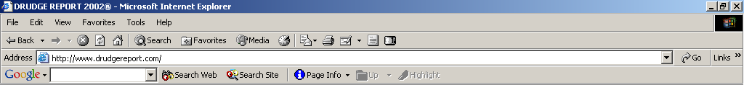
Web Design Principles
2
1
3
5
4

Slide 29
Web Design Principles
      Design for the User:
  Keep a Flat Hierarchy:
  Don’t make users navigate through too many layers to find the information they want
  Provide a simple menu for navigation
  Use the same navigation menu on all pages for uniformity
  Provide a site map that shows the user’s location in the Web site

Slide 30
Web Design Principles
      Design for the User:
  Use the Power of Hypertext Linking :
  Web pages enable a non-linear reading method (like reading a magazine)
  This can be done by providing hyperlinks through text or images
  Provide hyperlinks directly into the text
  Don’t use the “Click Here” phrase for linking
  Provide links that allow the user to jump to top of page, bottom of page, go the menu from anywhere in the page, etc

Slide 31
Web Design Principles
      Design for the User:
  How much Content is Enough?
  Don’t overload the user with too much information on a single page
  Compare the websites of Google, Yahoo, Times Of India
  Provide short paragraphs and links to more info for each topic.

Slide 32
Web Design Principles
      Design for the Screen:
  Shape of screen
  Provide enough contrast on page – light background and dark font
  Avoid light text on light background

Slide 33
Web Design Principles Summary
There are 4 principles:
      Design for Medium
      Design the Whole site
      Design for User
      Design for Screen

Slide 34
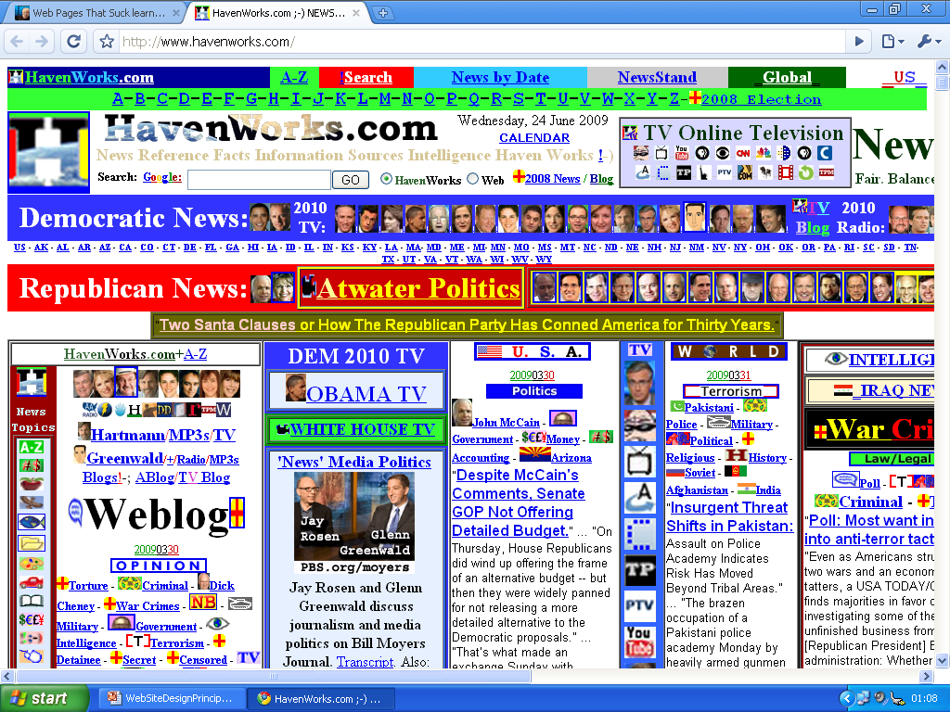
Worst Site

